Slide 1
Function Oriented Design and Structured Design Methodology

Slide 2
Program Structure and Structure Charts
Every program has a structure
Structure Chart - graphic representation of structure
SC represents modules and interconnections
Each module is represented by a box
If A invokes B, an arrow is drawn from A to B
Arrows are labeled by data items
Different types of modules in a SC
Input, output, transform and coordinate modules
A module may be a composite

Slide 3
Structure charts…
SC shows the static structure, not the logic
Different from flow charts
Major decisions and loops can be shown
Structure is decided during design
Implementation does not change structure
Structure effects maintainability
SDM aims to control the structure

Slide 4
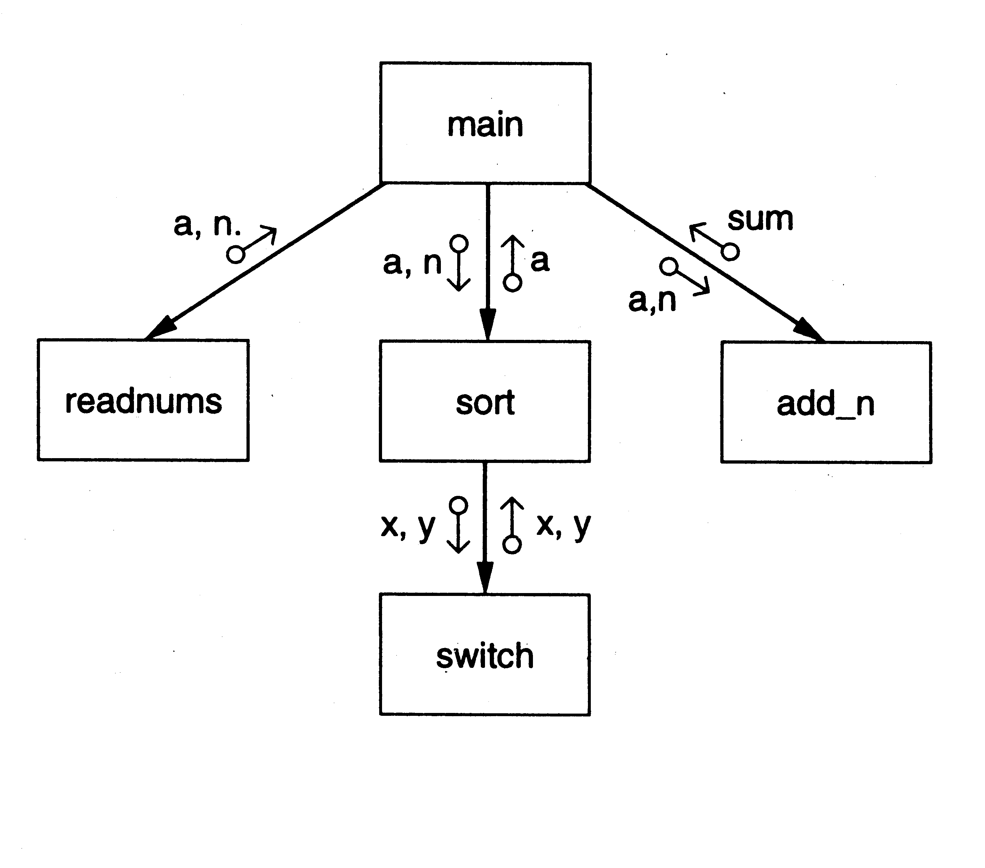
SC of a Sort Program

Slide 5
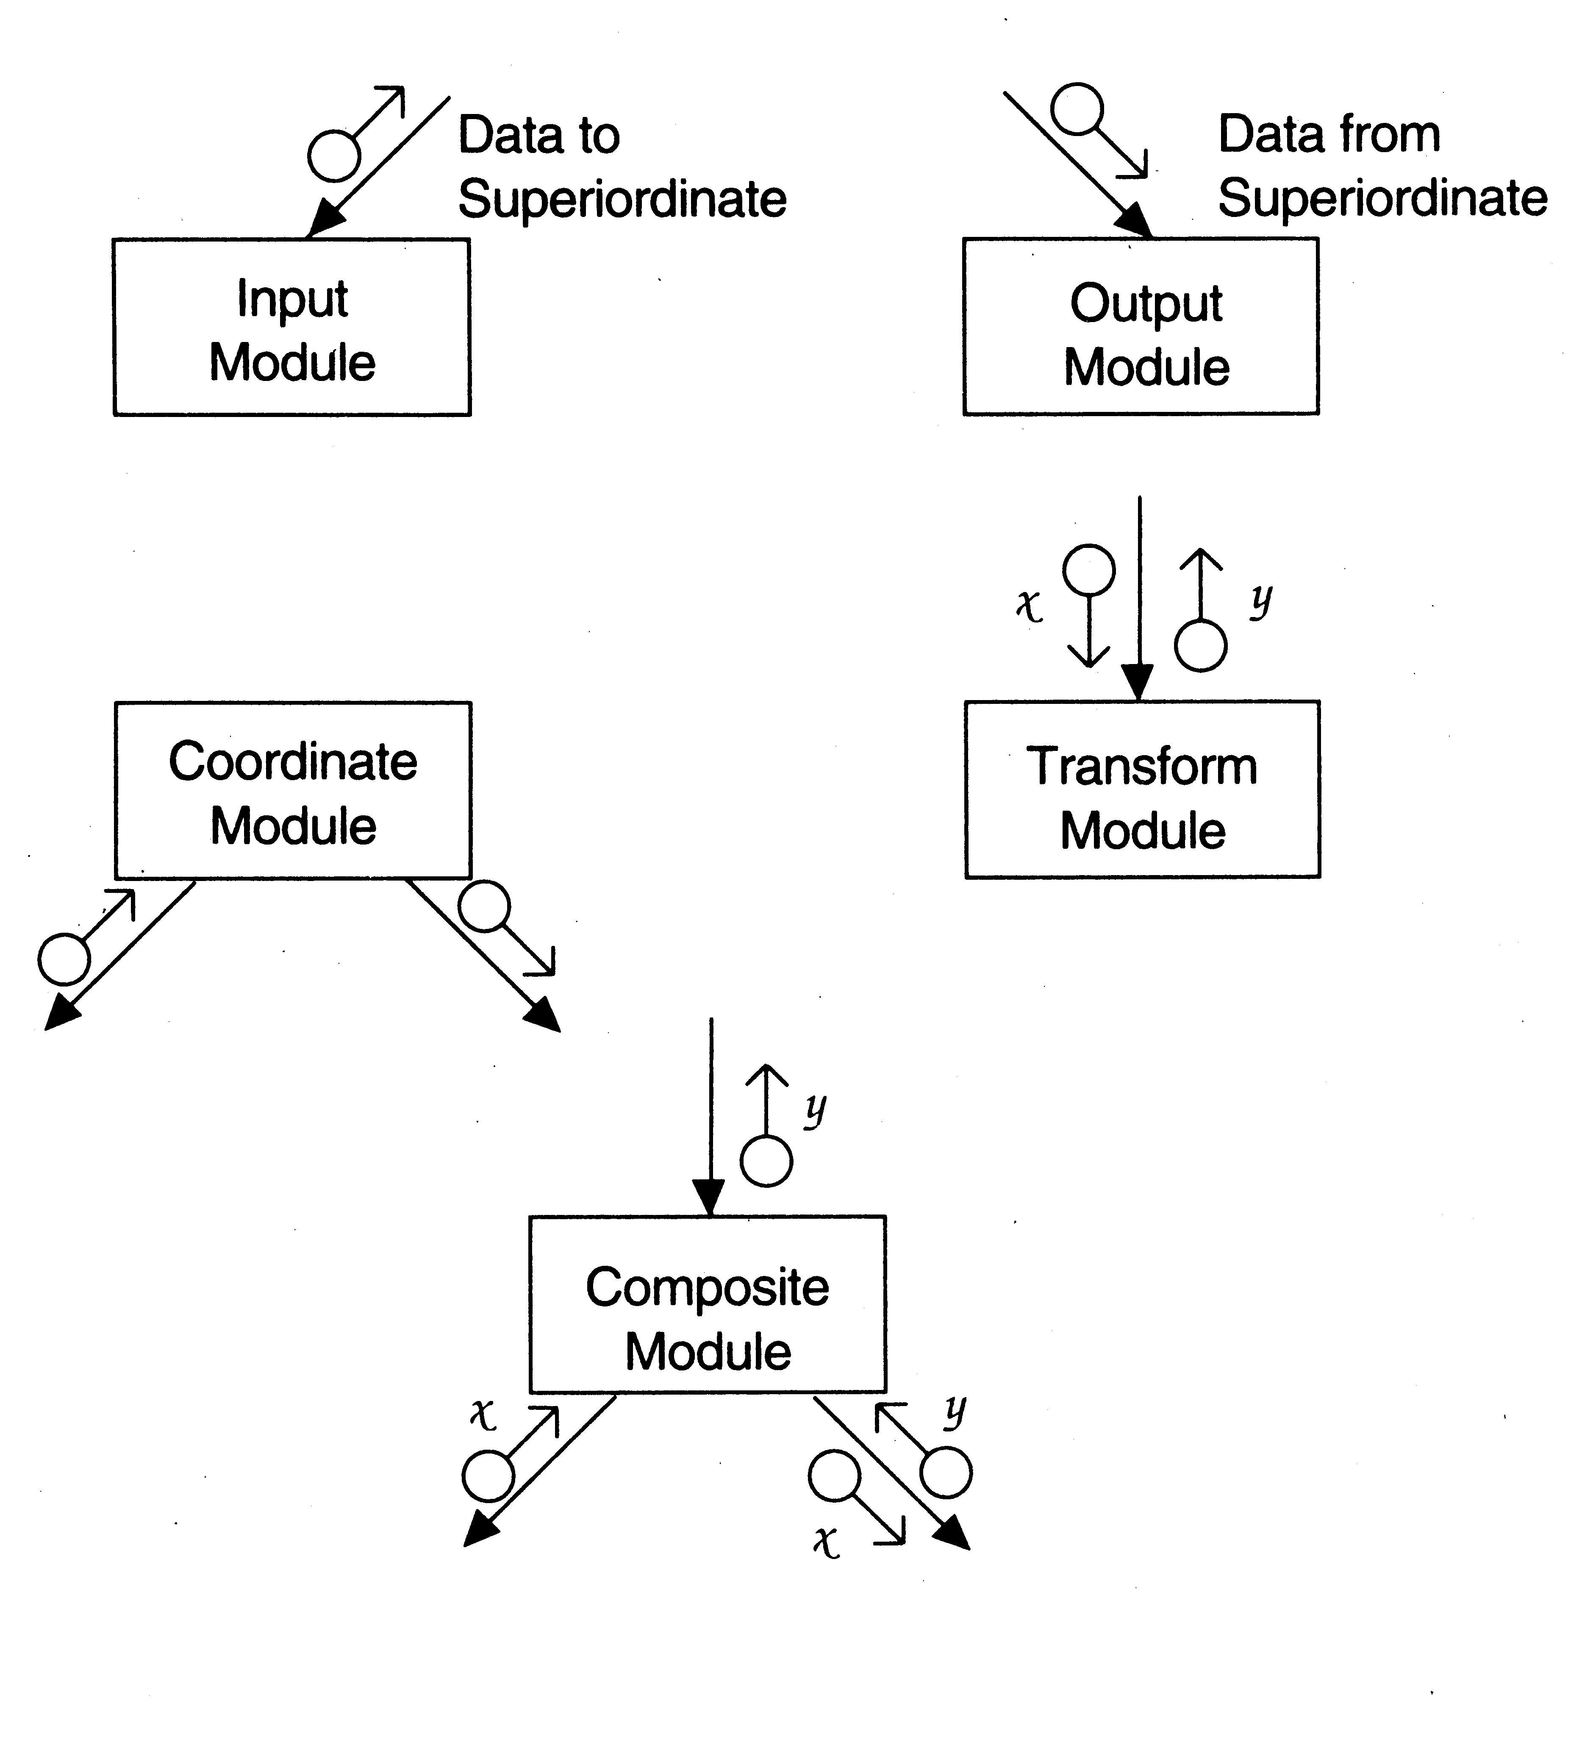
Diff types of modules

Slide 6
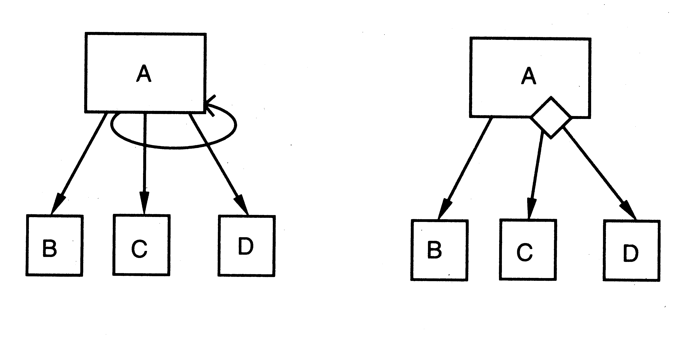
Iteration and decision

Slide 7
STRUCTURED DESIGN METHODOLOGY

Slide 8
STRUCTURED DESIGN METHODOLOGY
SDM views software as a transformation function that converts given inputs to desired outputs
The focus of SD is the transformation function
Uses functional abstraction
Goal of SDM: Specify functional modules and connections
Low coupling and high cohesion is the objective
Transformation
functions
Input
Output

Slide 9
Steps in SD
Draw a DFD of the system
Identify most abstract inputs and most abstract outputs
First level factoring
Factoring of input, output, transform modules
Improving the structure

Slide 10
1. Data Flow Diagrams
SD starts with a DFD to capture flow of data in the proposed system
DFD is an important representation; provides a high level view of the system
Emphasizes the flow of data through the system
Ignores procedural aspects
(Purpose here is different from DFDs used in requirements analysis, thought notation is the same)

Slide 11
Drawing a DFD
Start with identifying the inputs and outputs
Work your way from inputs to outputs, or vice versa
If stuck, reverse direction
Ask: "What transformations will convert the inputs to outputs"
Never try to show control logic.
If thinking about loops, if-then-else, start again
Label each arrow carefully
Make use of * and +, and show sufficient detail
Ignore minor functions in the start
For complex systems, make dfd hierarchical
Never settle for the 1st dfd

Slide 12
Step 2 of SD Methodology
Generally a system performs a basic function
Often cannot be performed on inputs directly
First inputs must be converted into a suitable form
Similarly for outputs - the outputs produced
by main transforms need further processing
Many transforms needed for processing inputs and outputs
Goal of step 2 is to separate such transforms from the basic transform centers

Slide 13
Step 2…
Most abstract inputs: data elements in dfd that are furthest from the actual inputs, but can still be considered as incoming
These are logical data items for the transformation
May have little similarity with actual inputs.
Often data items obtained after error checking, formatting, data validation, conversion etc.

Slide 14
Step 2…
Travel from physical inputs towards outputs until data can no longer be considered incoming
Go as far as possible, without loosing the incoming nature
Similarly for most abstract outputs
Represents a value judgment, but choice is often obvious
Bubbles between mai and mao: central transforms
These transforms perform the basic transformation
With mai and mao the central transforms can concentrate on the transformation

Slide 15
Step 2…
Problem View: Each system does some i/o and some processing
In many systems the i/o processing forms the large part of the code
This approach separates the different functions
subsystem primarily performing input
subsystem primarily performing transformations
subsystem primarily performing output presentation

Slide 16
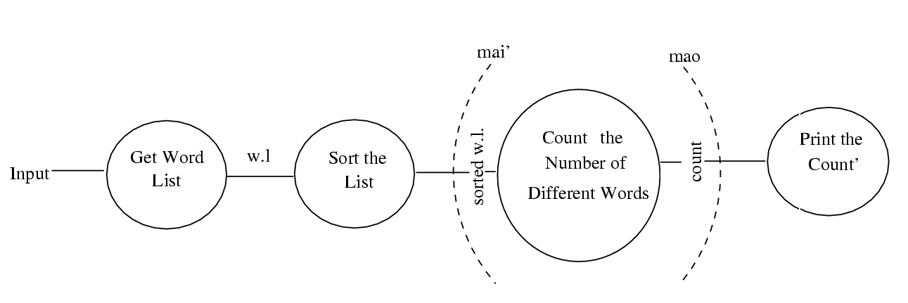
Example 1 – counting the no of different words in a file

Slide 17
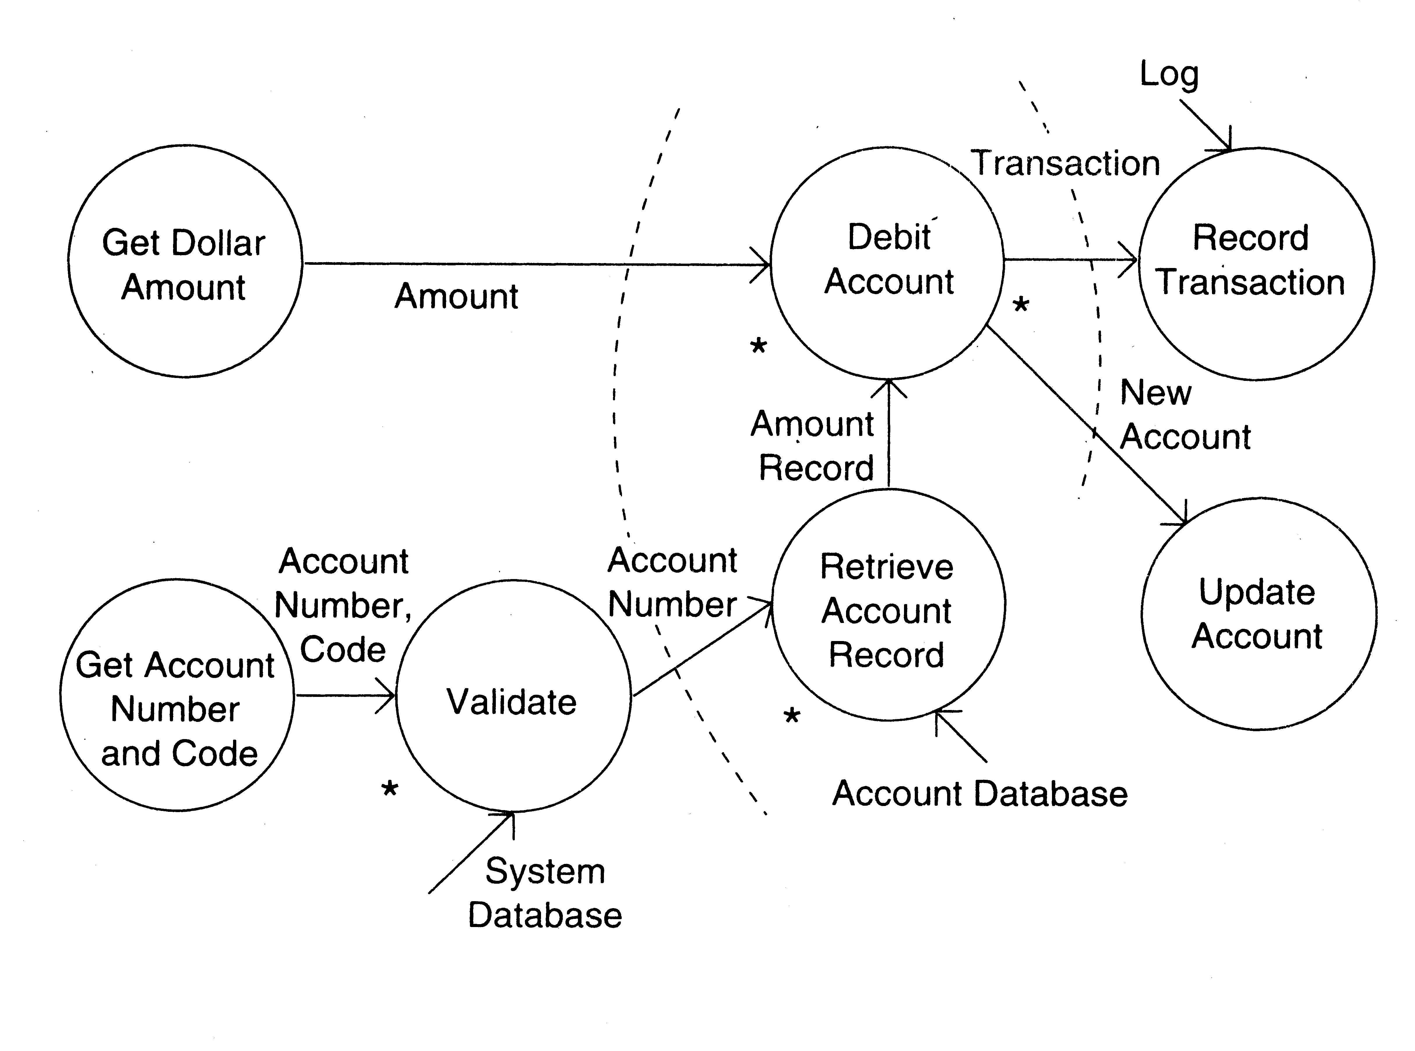
Example 2 – ATM

Slide 18
3. First Level Factoring
First step towards a structure chart
Specify a main module
For each most abstract input data item, specify a subordinate input module
The purpose of these input modules is to deliver to main the mai data items
For each most abstract output data element, specify an output module
For each central transform, specify a subordinate transform module
Inputs and outputs of these transform modules are specified in the DFD

Slide 19
First level factoring is straight forward
Main module is a coordinate module
Some subordinates are responsible for delivering the logical inputs
These are passed to transform modules to get them converted to logical outputs
Output modules then consume them
Divided the problem into three separate problems
Each of the three diff. types of modules can be designed separately
These modules are independent

Slide 20
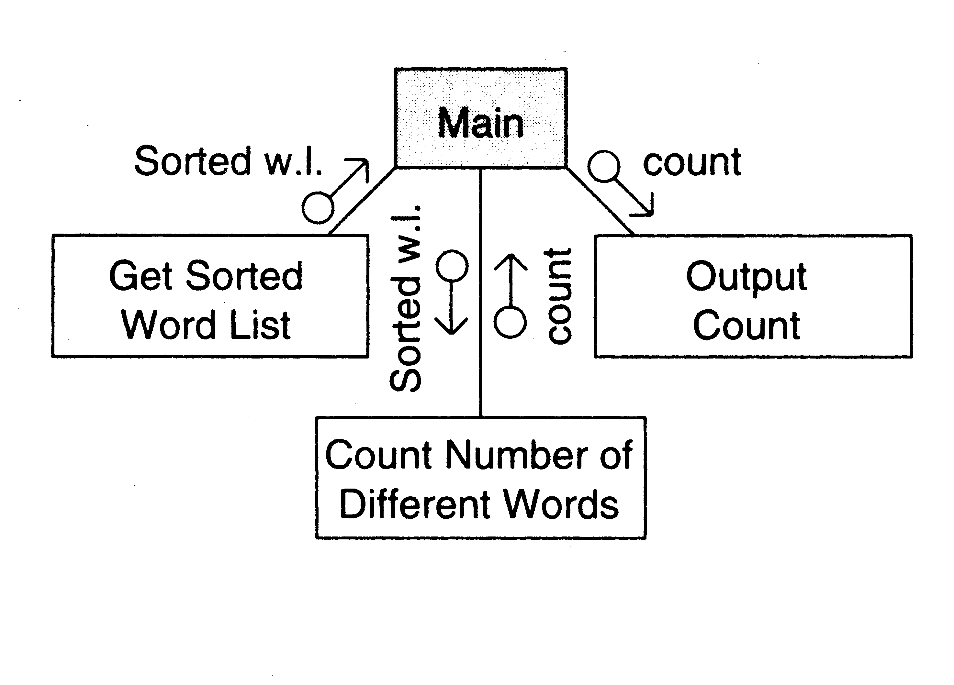
Example 1

Slide 21
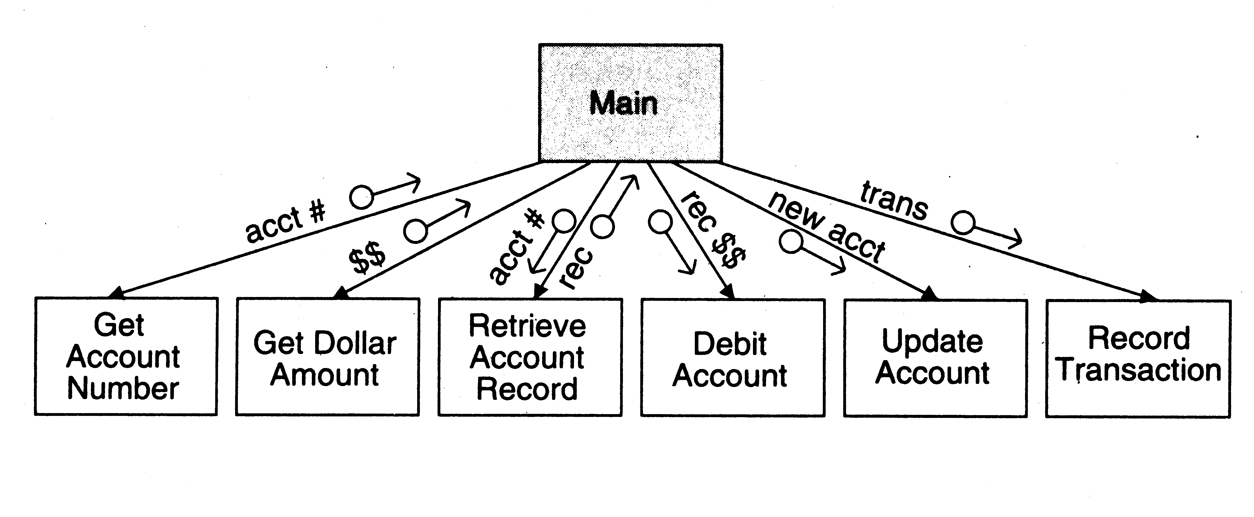
Example 2

Slide 22
4. Factoring Input modules
The transform that produced the mai data is treated as the central transform
Then repeat the process of first level factoring
Input module being factored becomes the main module
A subordinate input module is created for each data item coming in this new central transform
A subordinate module is created for the new central transform
Generally there will be no output modules

Slide 23
The new input modules are factored similarly Till the physical inputs are reached
Factoring of the output modules is symmetrical
Subordinates - a transform and output modules
Usually no input modules

Slide 24
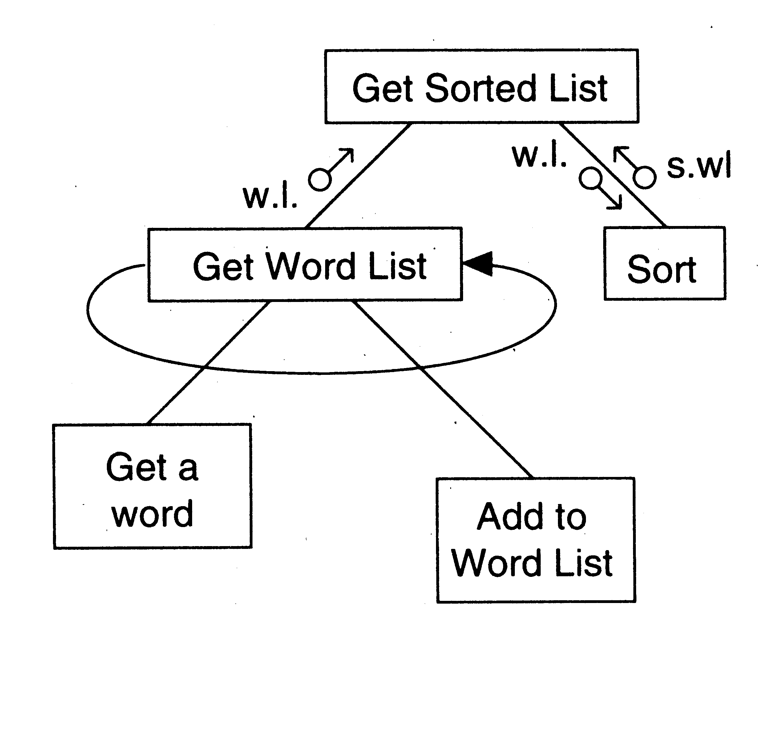
Example 1

Slide 25
Factoring Central Transforms
Factoring i/o modules is straight forward if the DFD is detailed
No rules for factoring the transform modules
Top-down refinement process can be used
Goal: determine sub-transforms that will together compose the transform
Then repeat the process for newly found transforms
Treat the transform as a problem in its own right
Draw a data flow diagram
Then repeat the process of factoring
Repeat this till atomic modules are reached

Slide 26
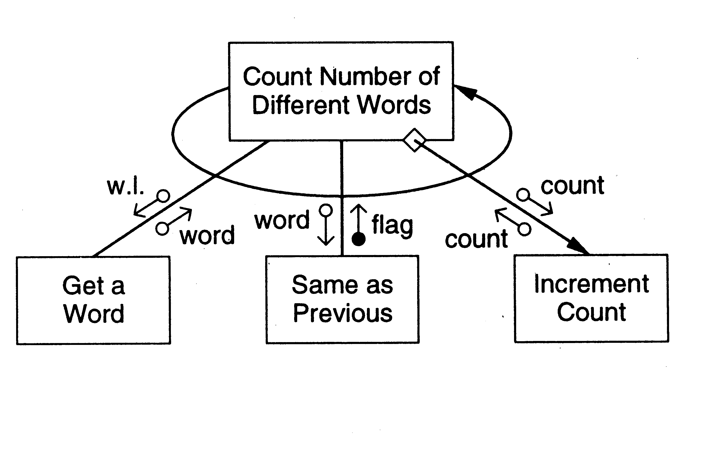
Example 1

Slide 27
5. Improving Design through Heuristics
The above steps should not be followed blindly
The structure obtained should be modified if needed
Low coupling, high cohesion being the goal
Design heuristics used to modify the initial design
Design heuristics - A set of thumb rules that are generally useful
Module Size: Indication of module complexity Carefully examine modules less than a few lines or greater than about 100 lines
Fan out and fan in
A high fan out is not desired, should not be increased beyond 5 or 6
Fan in should be maximized

Slide 28
Scope of effect of a module: the modules affected by a decision inside the module
Scope of control: All subordinates of the module
Good thumb rule:
For each module scope of effect should be a subset of scope of control
Ideally a decision should only effect immediate subordinates
Moving up the decision, moving the module down can be utilized to achieve this

Slide 29
Summary
Structured design methodology is one way to create modular design
It partitions the system into input subsystems, output subsystems & transform subsystems
Idea: Many systems use a lot of code for handling inputs & outputs
SDM separates these concerns
Then each of the subsystems is factored using the DFD
The design is finally documented & verified before proceeding

